Slide 1

Information
Retrieval
Project
Daniel Kuznetsov
Lior Nisimov

Slide 2

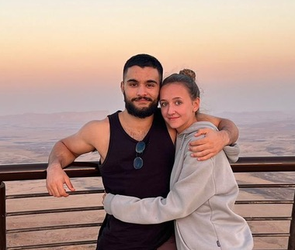
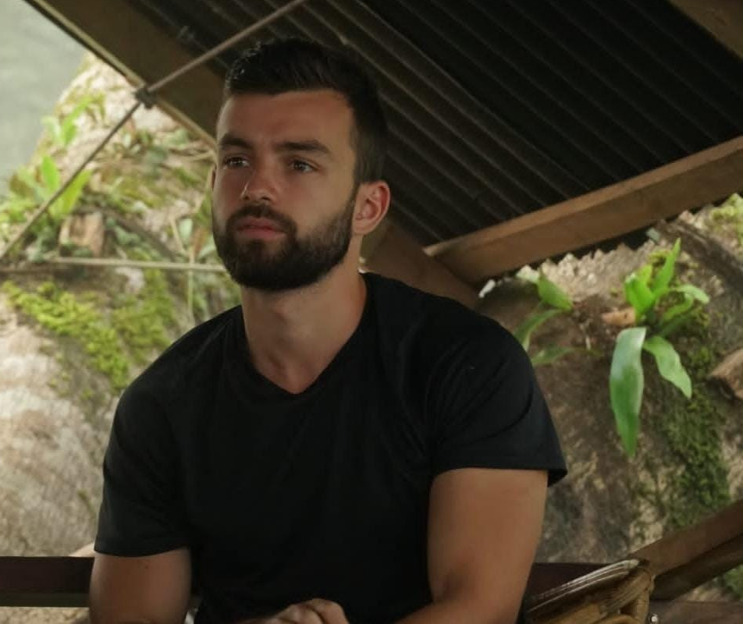
Hello!
We are Lior and Daniel :)

Slide 3
Project Roadmap
Understand how the different code pieces integrate with each other.
Implementing each element carefully in order to avoid bugs.
We stopped a little bit because one of us got sick.
The project is ready
1
3
5
2
4
6
Start to layout the major components of out project.
Connecting the pieces together.
Final integrations and testing.

Slide 4
The structure
search_frondend.py
backend.py
inverted_index_gcp.py
indexes _creator.ipynb

Slide 5
Key findings
Let’s talk about what we have found.

Slide 6
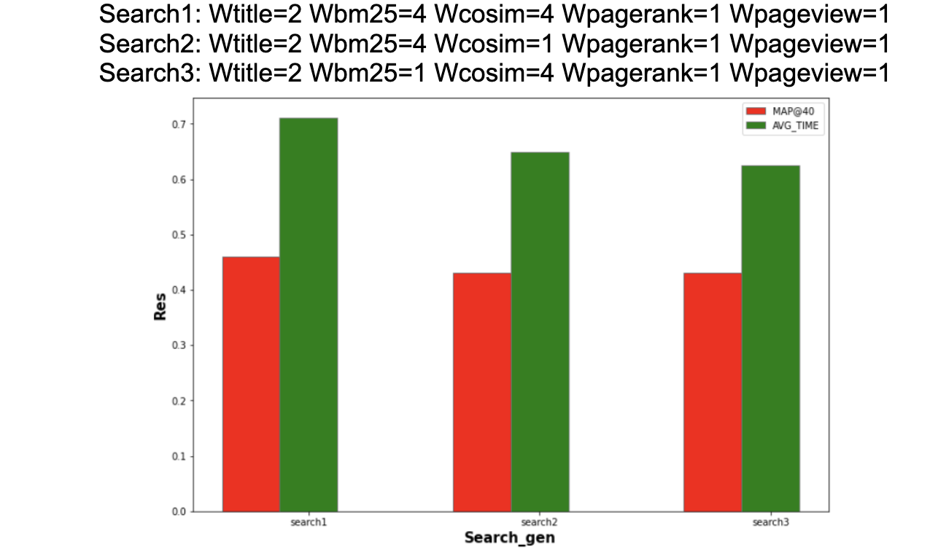

Slide 7
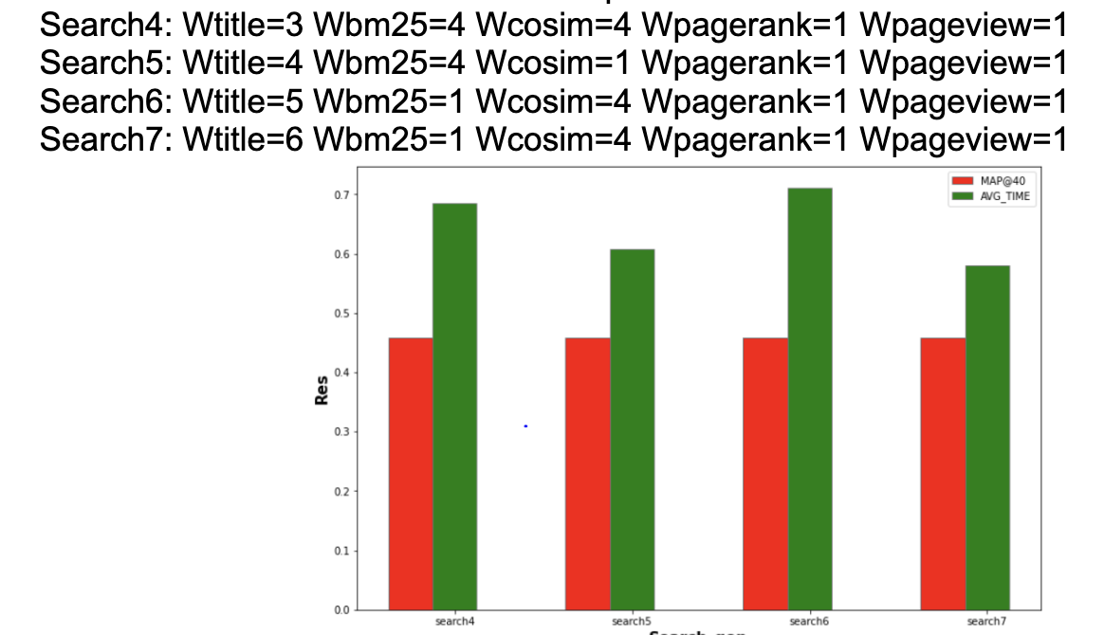

Slide 8
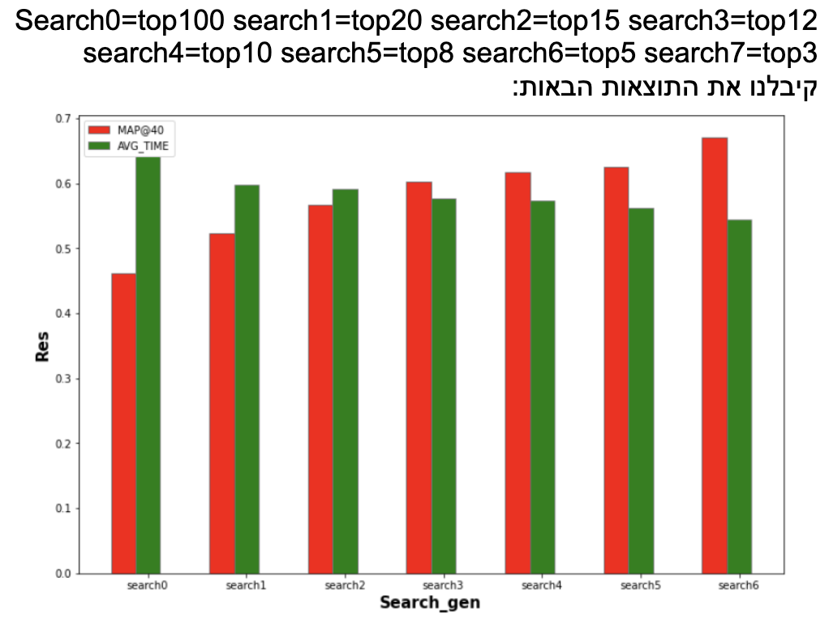

Slide 9
"A search engine is only as good as the information it provides; good information makes for a smart search engine." -
Sun Microsystems.

Slide 10
Challenges
The GCP is a hard platform to master.
The game plan was not clear
Small faults in the system
Notes:
Talk about the challenges in detail

Slide 11
Takeaways
Overall, like any project - there was a steep learning curve that demanded from us to break out mental barriers. But we managed to complete it :)

Slide 12
Thanks!
Any questions?
You can find us at:
liornis@post.bgu.ac.il
&
danielku@post.bgu.ac.il

